Slide 1

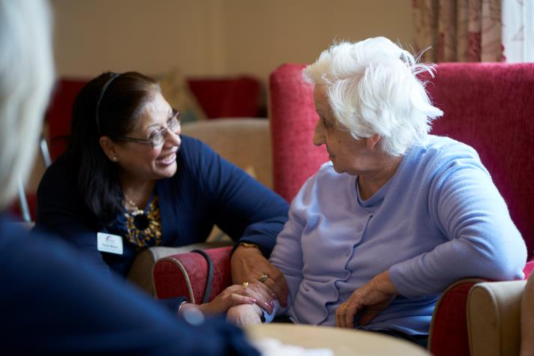
Practical Issues for
Chaplaincy Moving Forward
Prof. Chris Swift, Director of Chaplaincy & Spirituality at MHA
AHPCC Conference 15 May 2019

Slide 2
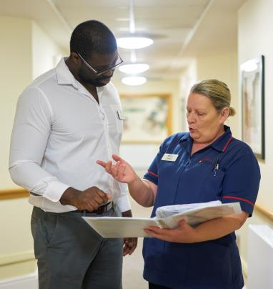
Context
  Chaplaincy
  A unique service in health & social care
  MHA: ‘intermediate hospice care’
  Typically significant involvement
  Dementia
Notes:
Chaplaincy - a life long passion
Prison - Health care - Military (Cardiff) - NHS 20 years - Social Care - Academic (‘visiting’ lol)
The Guardian today: ‘one in four postcode areas have no care provision’

Slide 3
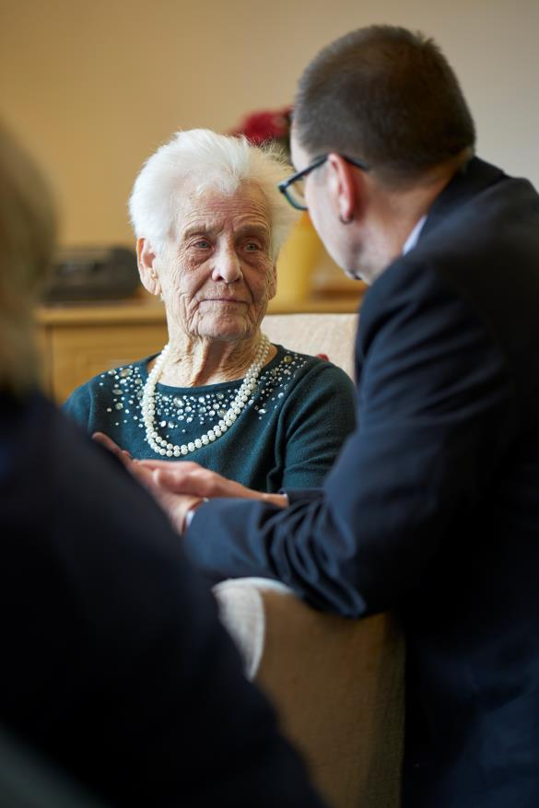
Deaths in MHA services
0.28 average deaths per resident p.a.
2018 1,553 deaths
End of Life Care Training
Impacts on staff
Notes:
Not hospices - but definitely providing

Slide 4
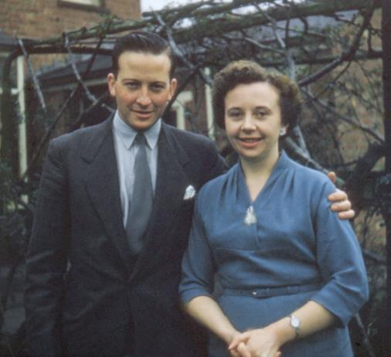
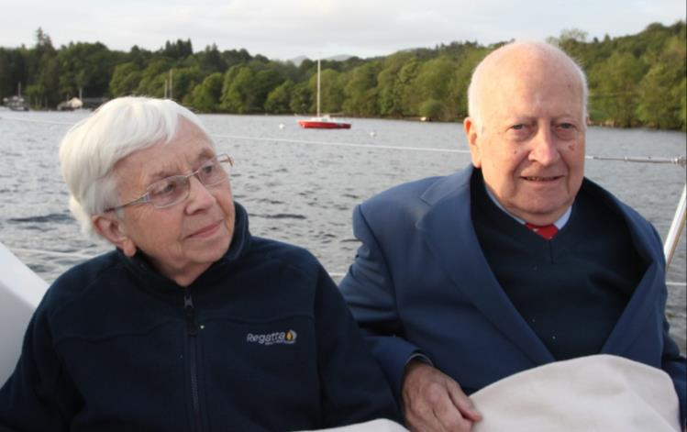
The transformation of age -
physical and spiritual
Notes:
Our perception of ageing - Miriam Margolyes - ‘Miriam’s Dead Good Adventure’ BBC 2; stays a night in a dementia care home

Slide 5
The Significance of Dementia
Nigel found his diagnosis ‘truly shocking’, but was more disturbed by how society now viewed and treated him.
‘Everybody saw me through the prism of dementia – I stopped being a person,’ he says.
Nigel Hullah, a former human rights lawyer who now has dementia
Notes:
The need to challenge negative stereotypes of later life; last socially acceptable prejudice

Slide 6
Moving Forwards - drivers
  Religion or belief is one of the nine protected characteristics in the Equality Act 2010. People have legal protection from being discriminated against because of religion or belief, or lack of religion or belief, under the Act.
  EHRC
  The commitment to patient/person centred care
Notes:
We all age; spiritually what does that mean for us and for others?

Slide 7

NHS guidance 2009
“As an employer and provider of healthcare services, the NHS should not only comply with the law, but should also aspire to be an exemplar of good practice…”

Slide 8
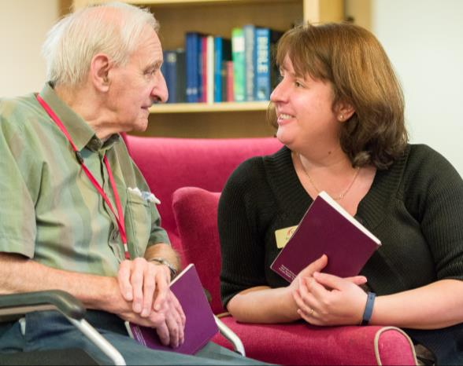
What is the legal position?
What is the legal position?
While in the care of an institution is there a duty on the organisation to facilitate human rights?
Rivers notes the limitation of HR in defining levels of access/service
Is there evidence that such exercise is curtailed in any way?
Notes:
Julian Rivers ‘Law and Organised Religion’

Slide 9

Minding our language
  Religion & Belief
  Spirituality & Pastoral Care
Notes:
We all age; spiritually what does that mean for us and for others?

Slide 10

Mr David Nott
– war zone
surgeon

Slide 11
“…are you a religious person?
No I’m not religious; but… every now and again I have to pray – and I do pray to God, and I ask him to help me, because sometimes I’m suffering badly… there’s no doubt in my mind that there is a God… when I need him he’s certainly there”.
Notes:
The politics of new atheism - Stuart McAnulla, book of the same name 2018 Routledge

Slide 12
It’s complicated
“It is important to recognize that persons with no religious affiliation do not necessarily lack a belief in God”.
Creel, E. and Tillman, K., 2008. The meaning of spirituality among nonreligious persons with chronic illness. Holistic nursing practice, 22(6), pp.303-309.

Slide 13
“in times of financial constraint, we often see equality and human rights as a challenge. We rarely look at equality and human rights as a solution. Yet, there is growing evidence that equality and human rights for people using services and staff needs to play a central role in improving the quality of care. And we are finding that some of the best providers are doing this successfully – even in times of constraint.”

Slide 14
Research, training & Innovation
  We all need to be involved
  Questioning; reflecting; sharing
  ‘Biblical Yoga’; evening services; contact cards; multi-sensory worship; transition into care; training (CPE)
  Creative memorial/reflective spaces

Slide 15
Pathways into chaplaincy
Foundation course
Depth of experience
Further study/enquiry
Board registered?
Formal training - courses & qualifications
Volunteer/speak to someone -
experience
Faith or belief?
I’d like to be a chaplain
CHCC Annual Conference 2018 “Curating Chaplaincy” - Session 2

Slide 16
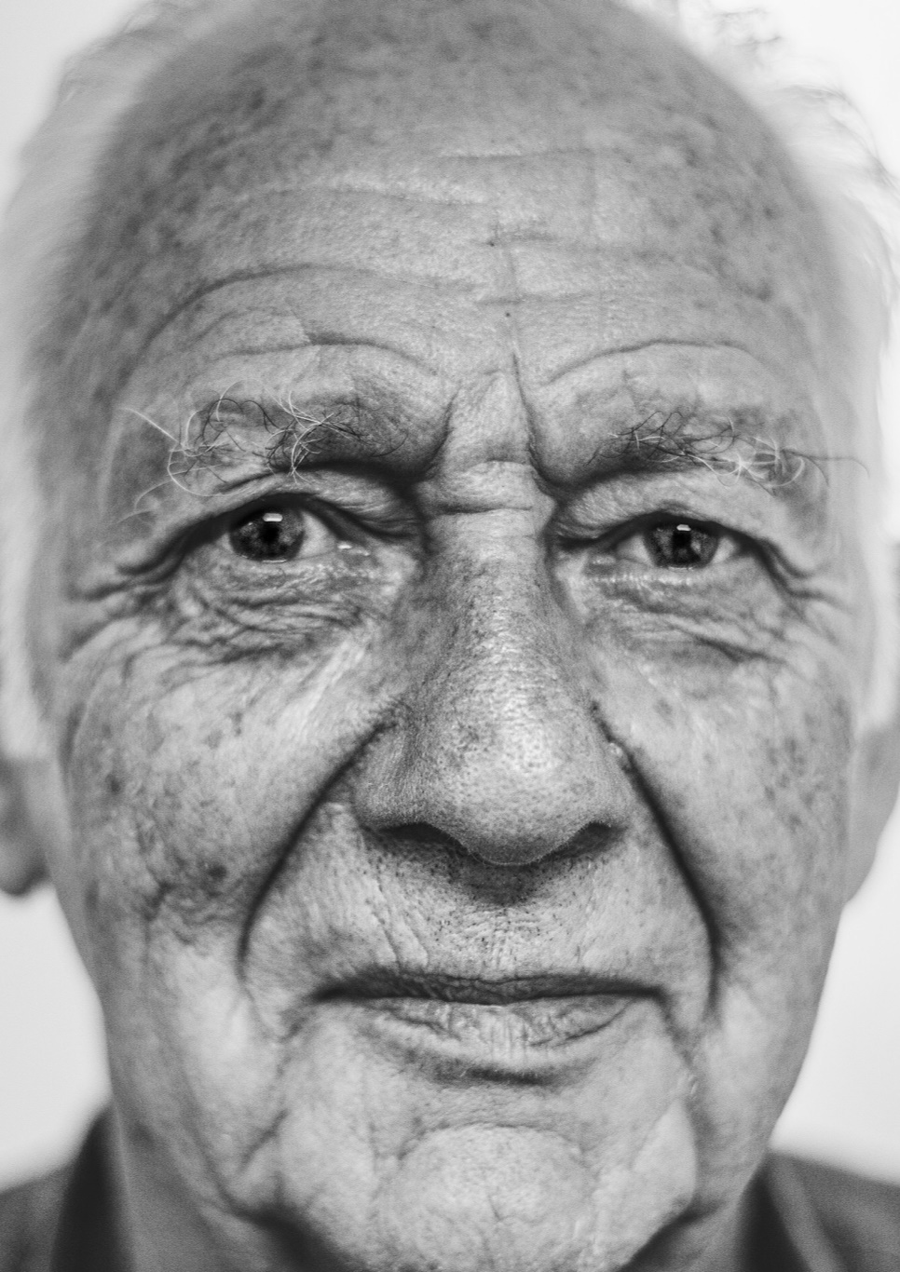
Promoting what’s unique about chaplaincy
Community focus
Handling meta-narratives
The shape of living
Unique communication

Slide 17
Comms: ordinary yet unusual
“this disarmingly simple yet highly skilled role is performed, beginning with the means by which patients are invited to disclose their concerns… even though the tools are commonplace ones which we can find in everyday conversation, what is important is that they are used by a caring professional at all…”
Harvey, Kevin, et al. "“Elicitation Hooks”: A Discourse Analysis of Chaplain-Patient Interaction in Pastoral and Spiritual Care." Journal of Pastoral Care & Counseling 62.1-2 (2008): 43-61.

Slide 18
So what?
More interrogation/understanding of what we do
Improving what we do - reimagining chaplaincy
Generating an appreciation of the non-niche (complex)
Partnerships - maximising capacity and applicability

Slide 19
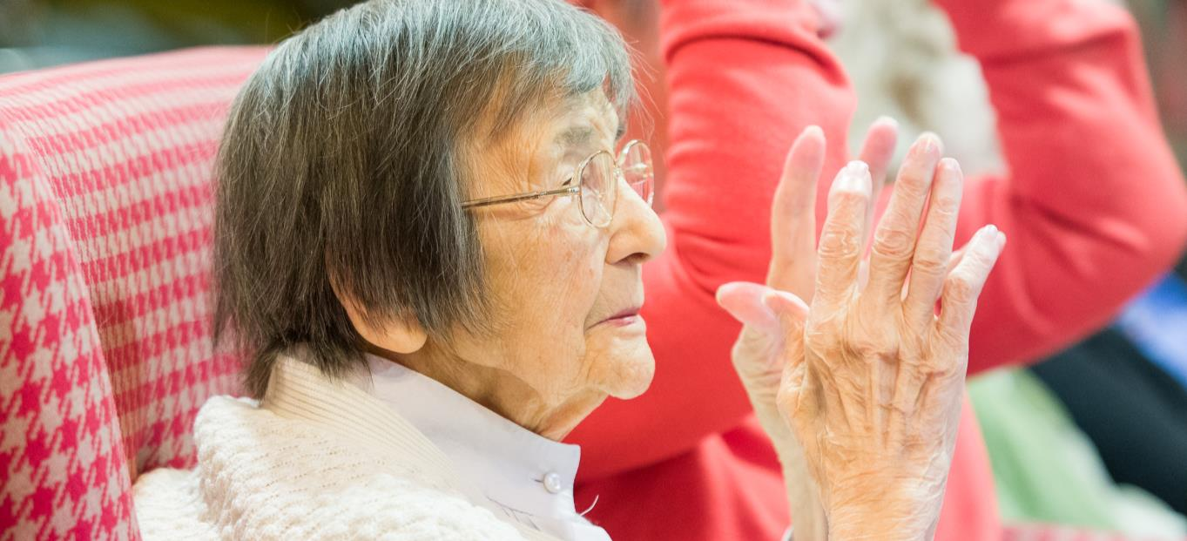

Slide 20

Thank you -
@chrisswift1
chris.swift@mha.org.uk

