Slide 1
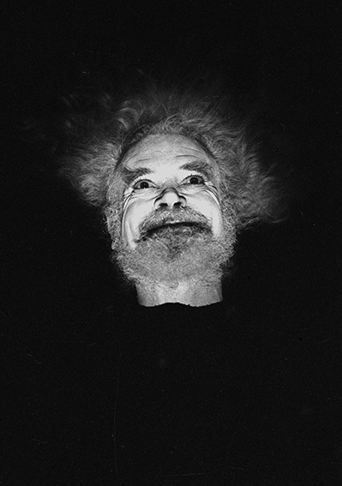
Dying Well: Beckett, Writing and the History of Care.
Literary, Historical and Practice-based research
AHRC Standard Grant
In Collaboration with the Association of Hospice and Palliative Care Chaplains
3 Years
PI: Conor Carville, Reading.
CI: Siobhan Campbell, Open University.
4 Literary-Historical Essays
4 Practice-based Research Essays.
Workshop Pack for Health Sector.

Slide 2
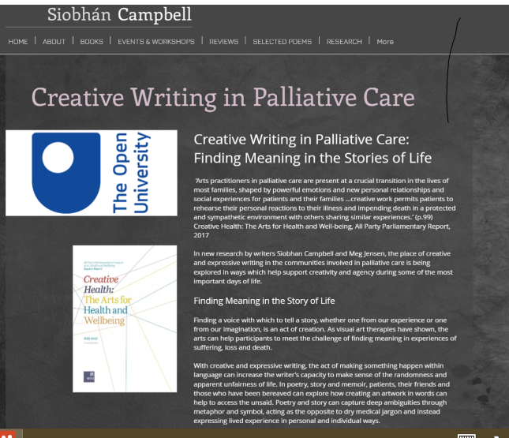
Siobhan Campbell (CI): Trinity Hospice Project

Slide 3
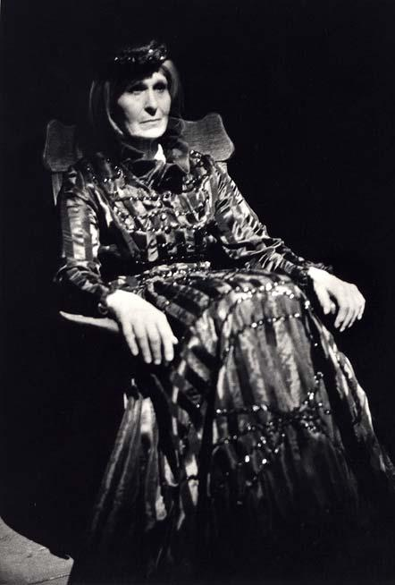
4 Areas of Research.
(a) Ritual and Medical Practices of Grief and Care
(1930s, Dublin and London). Murphy MS.
(b) The Denial of Death and the Rise of Palliative Care (1950s, Dublin, Paris). Theatrical Notebooks.
(c) Narration and the Good Death (1960s-1970s). That Time, MS and Recordings.
(d) Beyond Death: Medical Intervention and Extension of Life (1960s-1970s). Not I MS.

Slide 4
Letter/ First Love
My Dear Tom,
Father died last Monday afternoon after an illness lasting just under a week, and was buried the following Wednesday … Mother and I nursed him while he was ill… He was very beautiful when it was all over.
And my Father’s face, on his death bolster, had seemed to hint at some form of aesthetics relevant to man. But the faces of the living, all grimace and flush, can they be described as objects?

Slide 5
The little shabby respectable old men ... fly them (kites) almost out of sight, yesterday it was over the trees to the south, into an absolutely cloudless viridescent evening sky ... I was really rooted to the​ spot yesterday, unable to go away and wondering what was keeping me. Extraordinary effect too of birds flying close to the kites. My next old man, or old young man … must be a kite-flyer. So absolutely disinterested, like a poem, or useful in the depths where demand and supply coincide, and the prayer is the god. Yes, prayer rather than poem ...because poems are prayers, of Dives and Lazarus one flesh.

Slide 6
Murphy
Except for the sagging soar of line … there was nothing to be seen, for the kite had disappeared from view. Mr. Kelly was enraptured. Now he could measure the distance from the seen to the unseen, he was in a position to determine the point at which seen and unseen met. Rather, the experience he is after is one of delicate discrimination, the minimalist flicker of presence and absence at the very edge of perception. His later work will make this zone of experience its own.

Slide 7
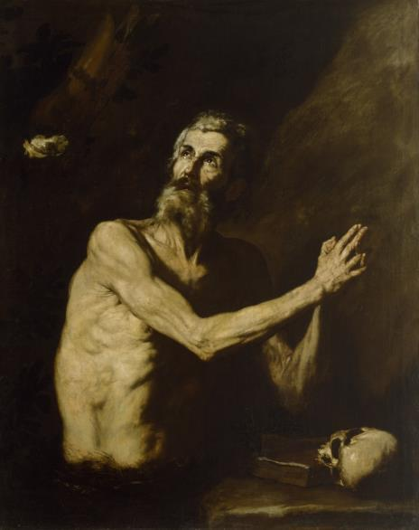

Slide 8
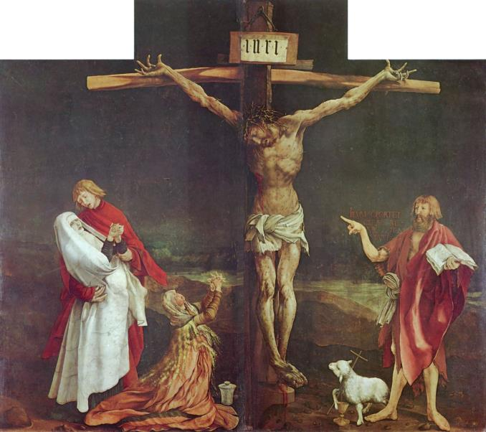
Grunewald: Isenheim Altar

Slide 9
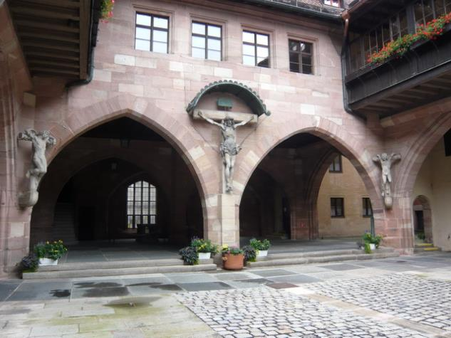
Helige Geist Spital

Slide 10
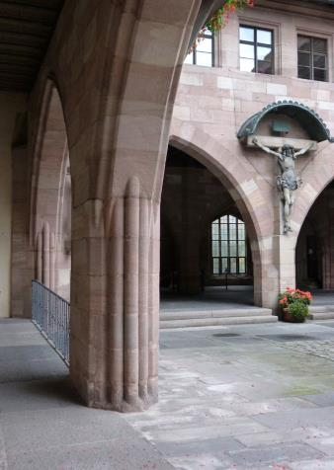
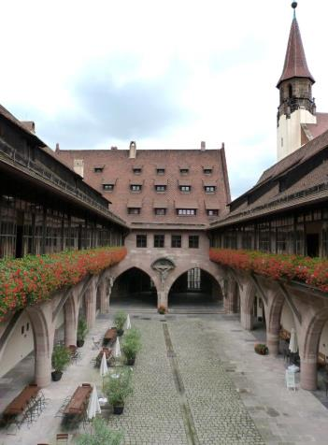

Slide 11
Unpublished poem 1937
I wish I were an old man
or an old woman
half & half
or an old hermaphrodite
if hermaphrodites live to be old
only old old as a crutch
with a room off the big yard
of the Holy Ghost Spital in Nürnberg
When the sun shines at midday on Adam Kraft’s
Big black stone Christ Crucified
But not on the repentant thief
Nor the unrepentant

Slide 12
Malone Dies
And each time it bangs against the jamb, my head does, for I am tall, and the landing is small, and the man carrying my feet cannot wait, before he starts down the stairs, for the whole of me to be out, on the landing I mean, but he has to start turning before that, so as not to bang into the wall, of the landing I mean. So my head bangs against the jamb, it’s inevitable. And it doesn’t matter to my head, in the state it is in, but the man carrying it says, Eh Bob easy!, out of respect perhaps, for he doesn’t know me, he didn’t know me, or for fear of hurting his fingers. Bang! Easy! Right! The door!, and the room is vacant at last and ready to receive, after disinfection, for you can’t be too careful, a large family or a pair of turtle dove

Slide 13
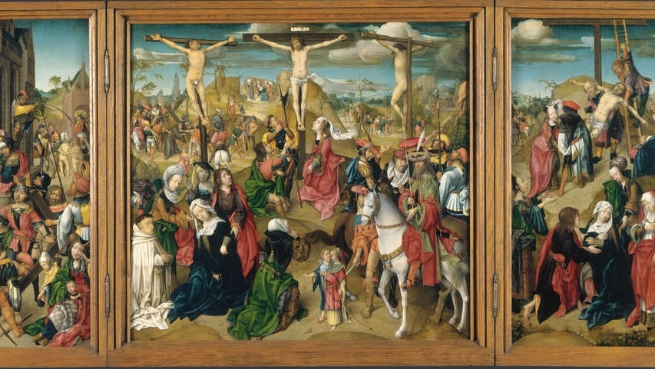
This Photo by Unknown Author is licensed under CC BY-SA

Slide 14
Ping!
White feet toes joined like sewn heels together right angle invisible. Eyes alone unover given blue light blue almost white. Murmur only just almost never one second perhaps not alone. Given rose only just bare white body fixed one yard white on white invisible. All white all known murmurs only just almost never always the same all known. Light heat hands hanging palms front white on white invisible. Bare white body fixed ping fixed elsewhere. Only the eyes only just light blue almost white fixed front. Ping murmur only just almost never one second perhaps a way out. Head haught eyes light blue almost white fixed front ping murmur ping silence. Eyes holes light blue almost white mouth white seam like sewn invisible. Ping murmur perhaps a nature one second almost never that much memory almost never.

Slide 15
Neither
TO AND FRO in shadow from inner to outershadow
from impenetrable self to impenetrable unself by way of neither
as between two lit refuges whose doors once neared gently close, once turned away from gently part again
beckoned back and forth and turned away
heedless of the way, intent on the one gleam or the other
unheard footfalls only sound
till at last halt for good, absent for good from self and other
then no sound
then gently light unfading on that unheeded neither
unspeakable home

